Slide 1
Programming Fundamentals AEC Coding Club

Slide 2
Content workflow
For loops
variables
If/else statements
Loops
Functions
APIs
variables types
While loops
Conditional Statements
Special Topics
Data Storage
Elements
Iteration Statements
*All Code are in C

Slide 3
Variables
1
Data item to store values

Slide 4
Variables in Algebra
a = 32
x=-13
Boring, eh!

Slide 5
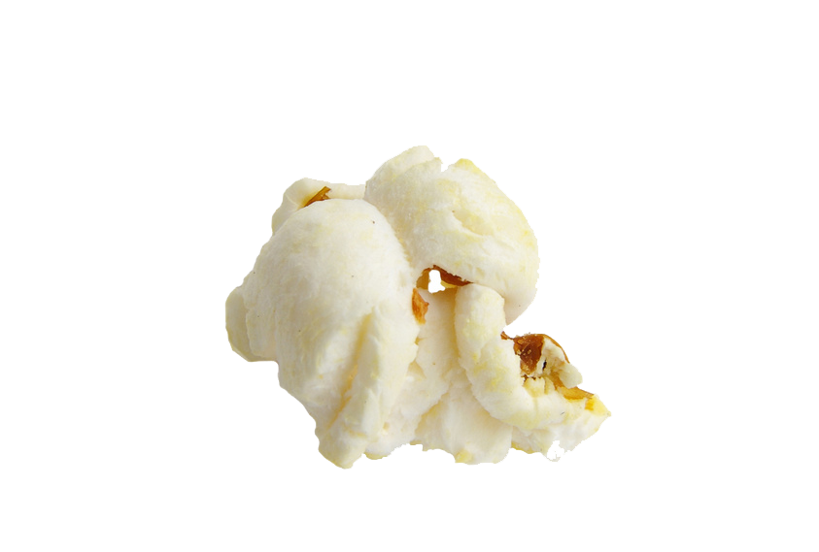
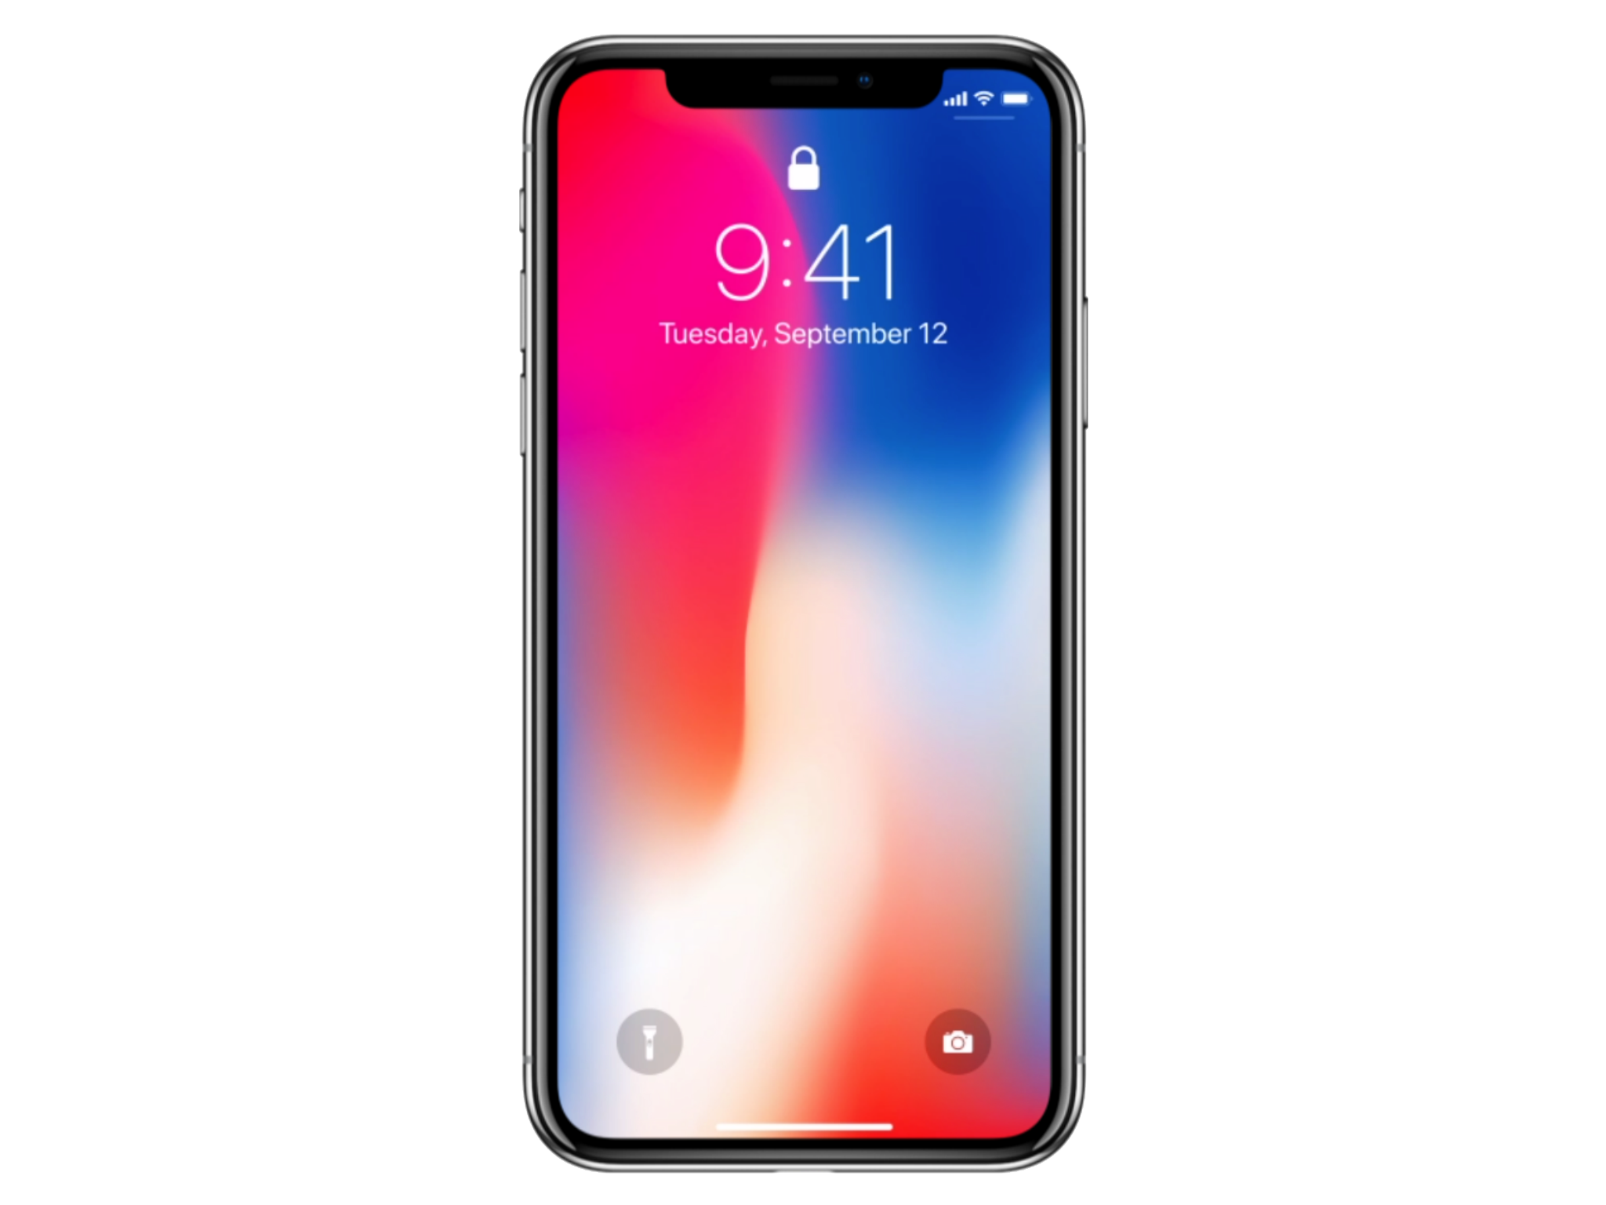
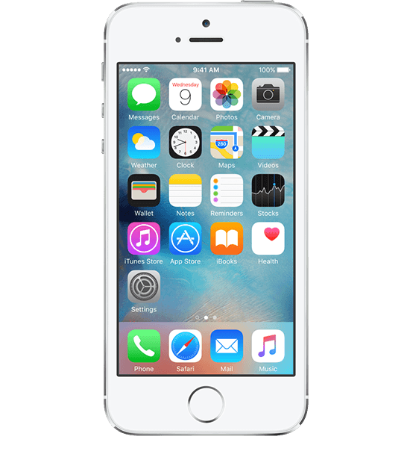
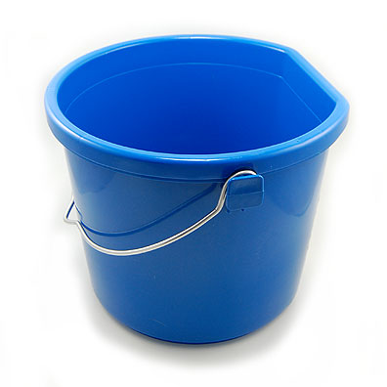
Analogies
emptyBucket
bucketOfphones
bucketOfpopcorn

Slide 6

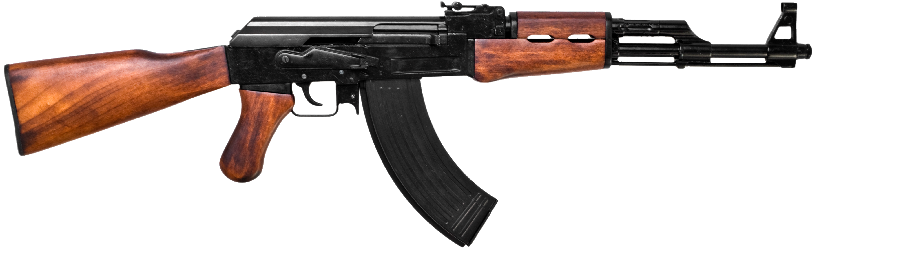
Analogies?
Bucket???

Slide 7
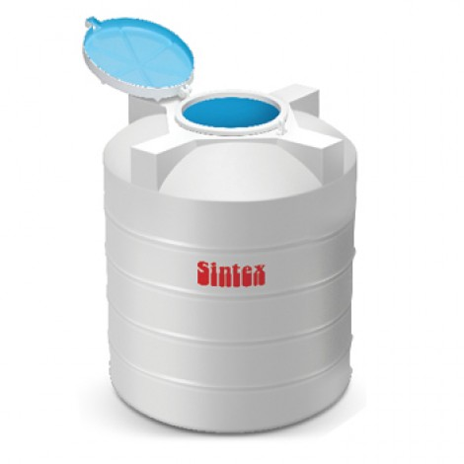
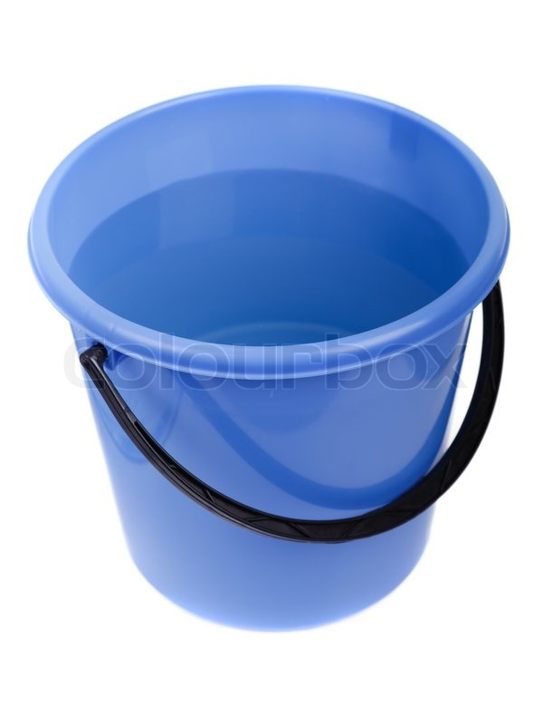
Variable Size

Slide 8
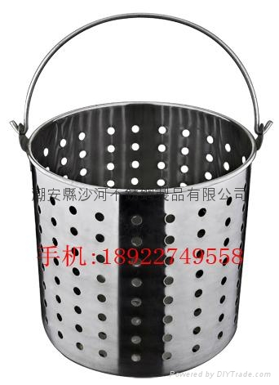
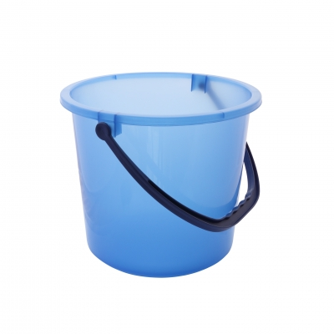
Variable Types

Slide 9
Variable Types
2

Slide 10
Integer Type
Range:
-2,147,483,648 to 2,147,483,647
(depends on computer)
Keyword: int
int tables = 13;
int chairs = 10;
int total = tables + chairs;
5/2?
11/2?

Slide 11
Float Type
Keyword: float
5/2?
float pi = 3.14159;
11/2?
float radius = 3.2;
float result =2*pi*radius;

Slide 12
Character Type
Keyword: char
Only one letter
char grade = \\\ \’A’;
“A computer can read only numbers”
char symbol =‘@’;
char small = ‘z’;

Slide 13
Char Array Type
Many characters
Keyword: char[length]
char name[20] = \\\ \’Hello, world’;
char number[10] = \\\ \’1234567890’;

Slide 14
Boolean Type
true or false
Keyword: bool
bool IsAvailable = \\\true;
bool safe = false;

Slide 15
Int vs. float
int bucket = 13;
float tank = bucket;

Slide 16
Variable Size
int
float

Slide 17
Int vs. float
13.00000

Slide 18
Int vs. float
float tank =3.14159;
int bucket = tank;

Slide 19
Variable Size
int
float

Slide 20
Int vs. float
3

Slide 21
char
int number = 15;
float fract = 1.5;
*
char title = number;
char title = fract;

Slide 22
Variable Types

Slide 23
Variables in Programming
int number = 32;
char grade = ‘A’;

Slide 24
Content workflow
For loops
variables
If/else statements
Loops
Functions
APIs
variables types
While loops
Conditional Statements
Special Topics
Data Storage
Elements
Iteration Statements
*All Code are in C

Slide 25
If/else statements
3
Conditional statement

Slide 26
If else
{…}

Slide 27
Question:
Are you Vegetarian?

Slide 28
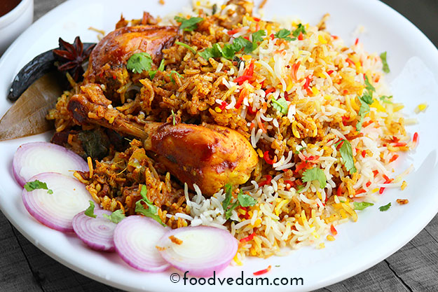
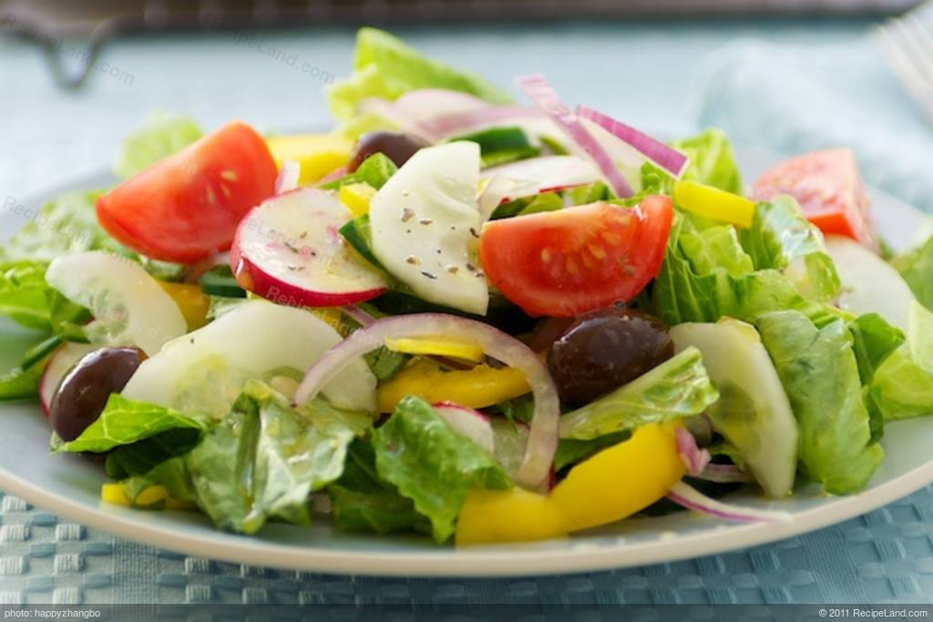
Conclusion:
Yes
No

Slide 29
Psuedocode:
If(IsVegetarian ==false){
chickenBiryani.eat();
}
else{
salad.eat();
}

Slide 30
If else if else
{…}

Slide 31
Question:
What is your age?

Slide 32

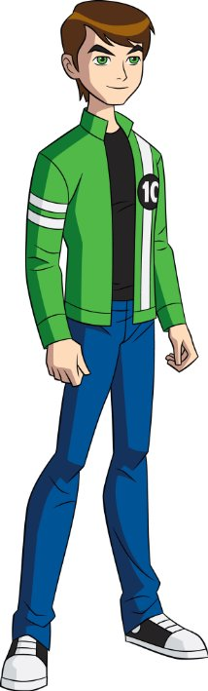
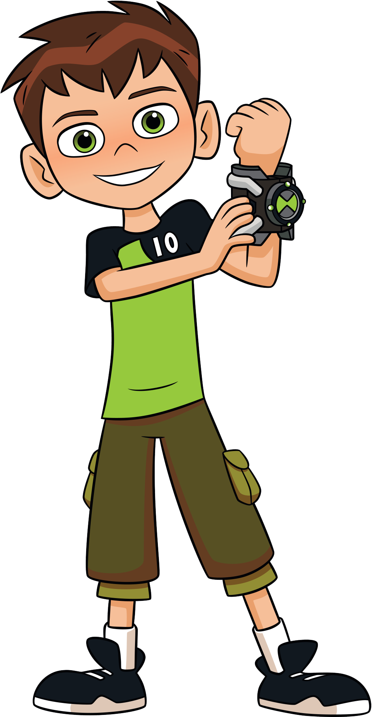
Conclusion:
age<=11
11<age<18
age>=18

Slide 33
Psuedocode:
If(age<=11){
You are a child
}
else if(18>age>11 {
You are a teenager
}else{
You are an adult
}

Slide 34
Nested if
{…}

Slide 35
Question:
Biryani or Chow Mein?

Slide 36
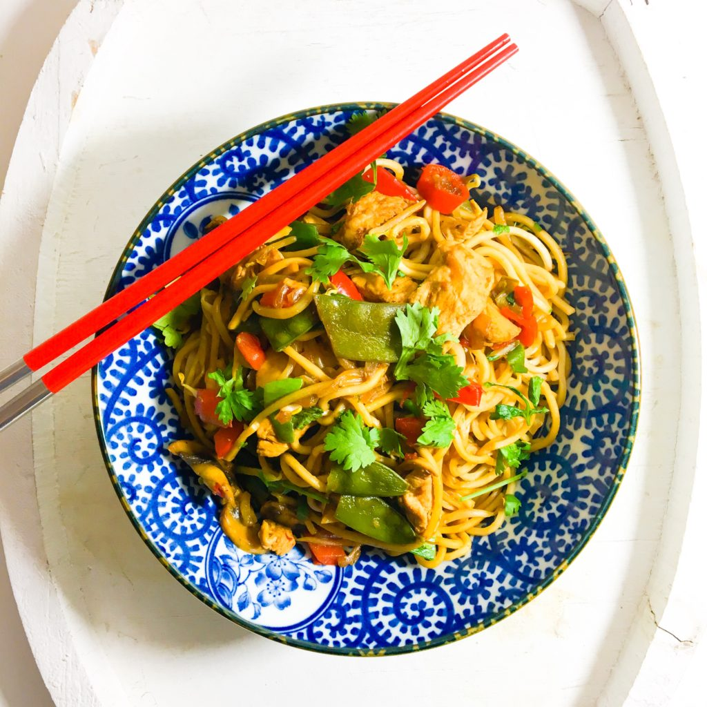
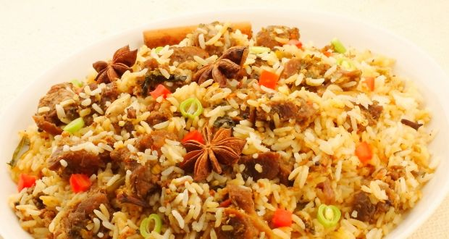
Conclusion:

Slide 37
Another choice:
Chicken
Veg
Egg

Slide 38
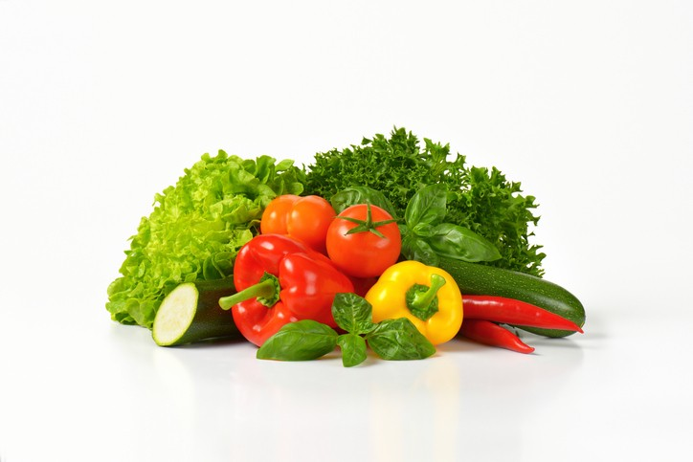
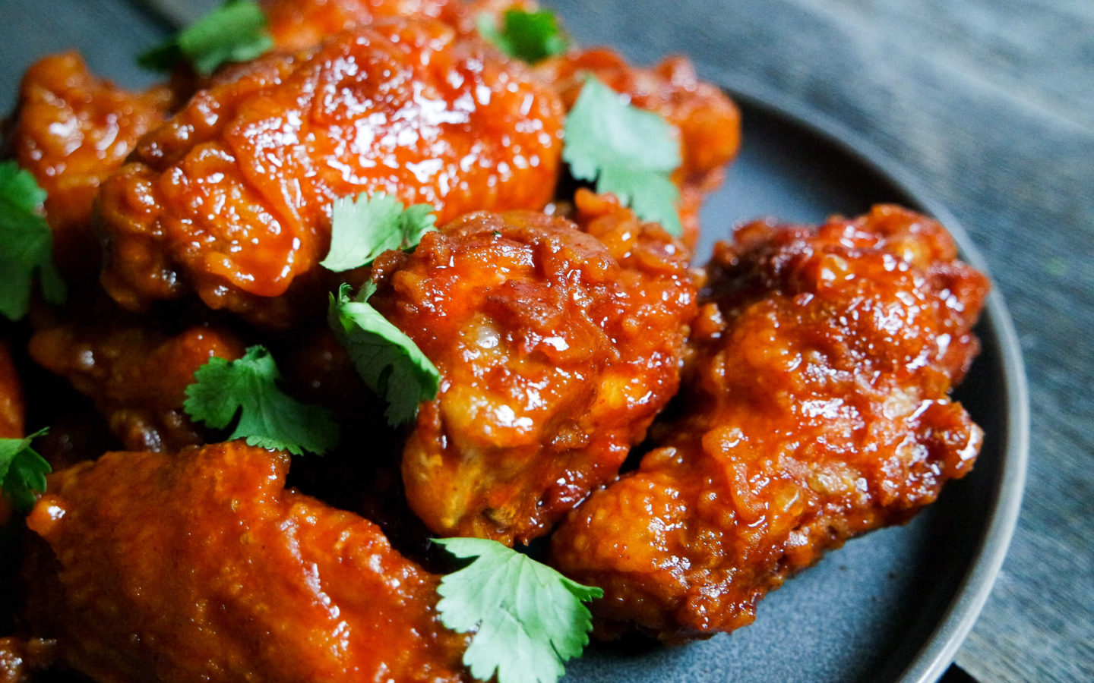
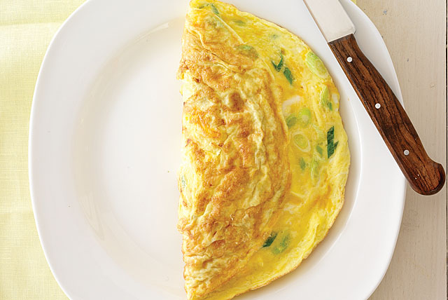
Again:
Chicken
Veg
Egg

Slide 39
Psuedocode:
If(biryani==true){
if(veg==true){
biryani.veg.serve();
}else if(egg==true){
biryani.egg.serve();
}else{
biryani.nveg.serve();
}
}
else{
if(veg==true){
chow.veg.serve();
}else if(egg==true){
chow.egg.serve();
}else{
chow.nveg.serve();
}
}

Slide 40
Loops
3
Iterative Statements

Slide 41
Teacher said:
Write “I shall not do it again”
100 times on the board.

Slide 42
Blackboard:
print (“I shall not do it again”)
print (“I shall not do it again”)
print (“I shall not do it again”)
print (“I shall not do it again”)
print (“I shall not do it again”)
print (“I shall not do it again”)
print (“I shall not do it again”)
print (“I shall not do it again”)
print (“I shall not do it again”)
print (“I shall not do it again”)
print (“I shall not do it again”)
print (“I shall not do it again”)
print (“I shall not do it again”)
print (“I shall not do it again”)
print (“I shall not do it again”)
print (“I shall not do it again”)
print (“I shall not do it again”)
print (“I shall not do it again”)
print (“I shall not do it again”)
print (“I shall not do it again”)
print (“I shall not do it again”)
print (“I shall not do it again”)
print (“I shall not do it again”)
print (“I shall not do it again”)
more below

Slide 43
Psuedocode:
for(count=0;count<100;count++){
print (“I shall not do it again”)
}

Slide 44

Countdown:

Slide 45
Psuedocode:
int counter = 5;
while(counter >= 0){
print(counter);
counter=counter-1;
}

Slide 46
For loop:
for(count=0;count<100;count++){
print (“I shall not do it again”)
}

Slide 47
While loop:
int counter = 5;
while(counter >= 0){
print(counter);
counter=counter-1;
}

Slide 48
Content workflow
For loops
variables
If/else statements
Loops
Functions
APIs
variables types
While loops
Conditional Statements
Special Topics
Data Storage
Elements
Iteration Statements

Slide 49
Functions
5
a procedure/a routine

Slide 50
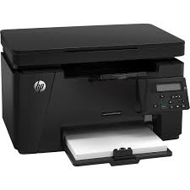
Example: a printer
print()
copy()
scan()

Slide 51
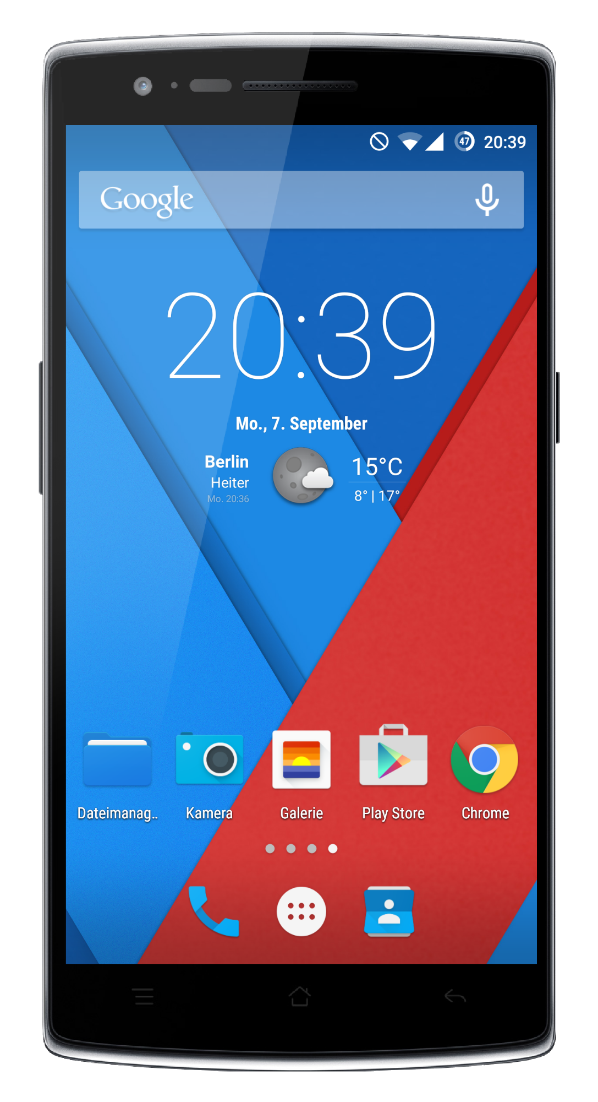
Example: a smartphone
play.video()
call()
play.audio()
text()
browse()
click.photos()
download()
runapps()

Slide 52
Psuedocode: factorial
5
int fact(int x){
int res = 1;
for(int i=1;i<x;i++){
res=res*i;\
}
return res;
}
f(x)
120

Slide 53
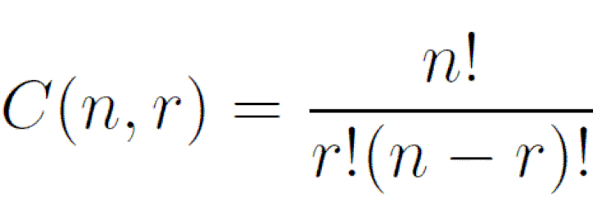
Psuedocode: combination
Find ⁵C₂
int combination = fact(5)/fact(2)*fact(5-2);

Slide 54
APIs
1

Slide 55
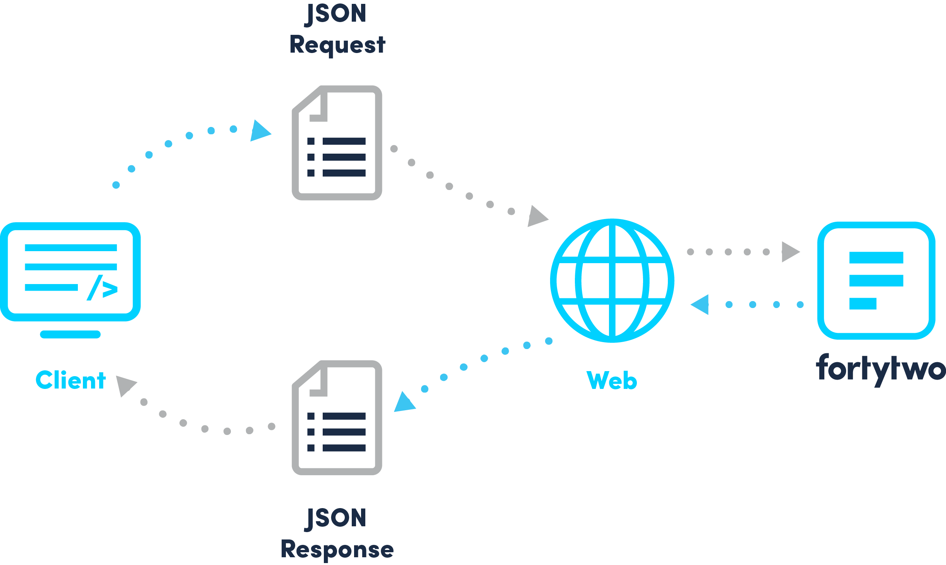
Web API
data

Slide 56
Thanks!
Any questions?

